Slide 1

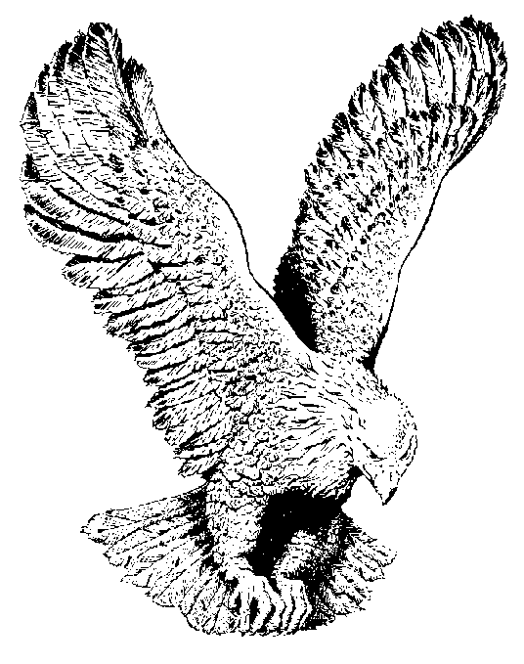
696 ISAIAH 40:11
He shall feed His flock like a Shepherd
He shall gather the lambs with His arms
And carry them in His bosom
And gently lead those that are with young.

